Slide 1
DIGITAL PORTFOLIO
❑ STUDENT NAME : arun kumar.s
❑ REGISTER NO AND NMID::215EBBAC056670AA96147A709CFD5472
❑ DEPARTMENT: BSc.information technology
❑ COLLEGE: BHARADHIYAR UNIVERSITY

Slide 2
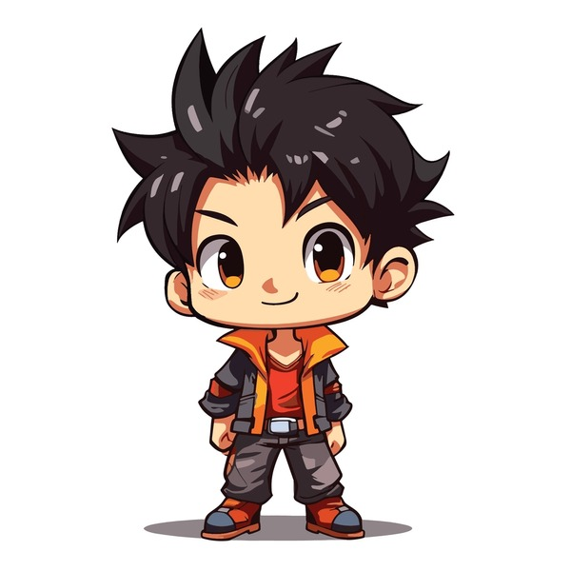
Project title
Arun kumar’s Portfolio

Slide 3

AGENDA
Problem statement ○ Project overview ○ Tools and technologies ○ Portfolio design and layout ○ Features and functionality ○ Result and screenshots ○ Conclusion ○ GitHub link

Slide 4
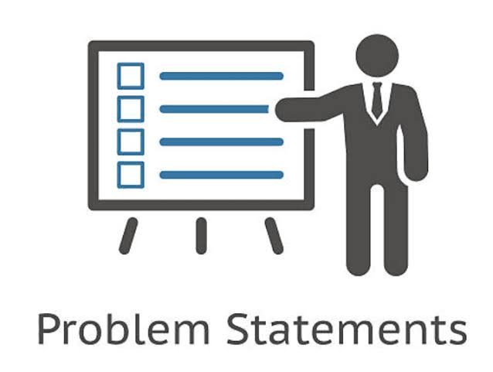
PROBLEM STATEMENT
○ *Problem Statement:* ○ “Students often face challenges in effectively showcasing their academic achievements, projects, skills, and extracurricular involvement using traditional methods like paper resumes or verbal presentations. These formats do not fully capture their potential or creativity. A digital portfolio provides a modern, interactive solution that allows students to present their work in a more engaging, organized, and accessible way for teachers, peers, and future opportunities.”

Slide 5
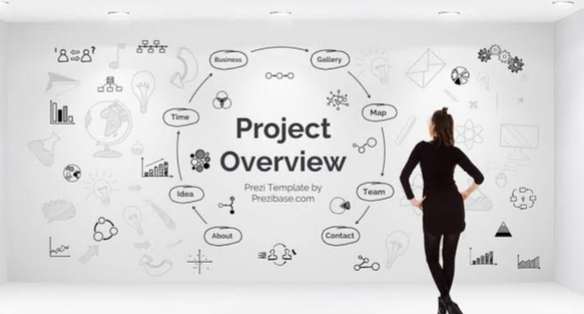
PROJECT OVERVIEW
○ *Project Overview:* ○ This project aims to develop a digital portfolio platform specifically designed for students to document and showcase their academic progress, personal achievements, skills, and creative work. The digital portfolio will serve as a centralized, accessible, and organized space where students can upload assignments, display projects, track learning goals, and reflect on their growth over time. It will also include features like multimedia support (images, videos, PDFs), customizable layouts, and secure sharing options for teachers, peers, and potential employers. The goal is to empower students to take ownership of their learning and build a professional online presence.

Slide 6
HOW ARE THE END USERS
○ *Students* –To create, update, and showcase their work and achievements. ○ *Teachers/Educators* –To review student progress, give feedback, and assess learning. ○ *Parents/Guardians* –To monitor their child’s academic development and involvement. ○ *School Administrators* –To evaluate student outcomes and curriculum effectiveness. ○ *College Admissions Officers* –To assess applicants beyond grades and test scores. ○ *Employers/Internship Coordinators* –To view a student’s skills, projects, and experience.

Slide 7
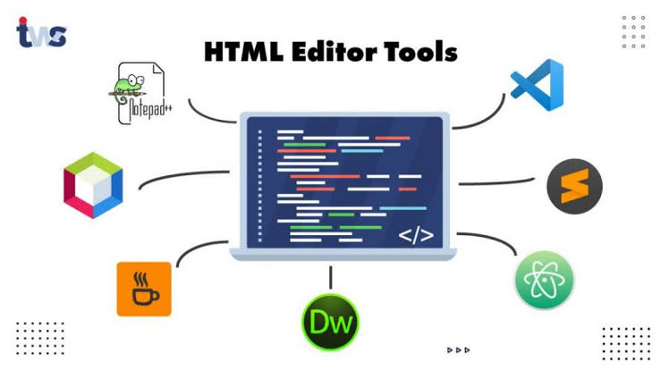
TOOLS AND TECHNIQUES OF HTML
○ *Tools:* ○ 1. *Text Editors* –VS Code, Sublime Text, or Notepad++ ○ 2. *Web Browsers* – Chrome, Firefox (for testing and viewing) ○ 3. *Version Control* –Git & GitHub (for managing code versions) ○ 4. *Frameworks* – Bootstrap (for responsive design) ○ 5. *Graphics Tools* – Canva, Figma (for visuals/images) ○ *Techniques:* ○ 1. *HTML5 Structure* – Using `<!DOCTYPE html>`, `<header>`, `<nav>`, `<main>`, `<footer>`, etc. ○ 2. *Forms* – For collecting data or feedback (using `<form>`, `<input>`, `<textarea>`) ○ 3. *Multimedia Embedding* – Adding images, audio, and video using `<img>`, `<audio>`, `<video>` ○ 4. *Links & Navigation* –Using `<a>` tags and lists (`<ul>`, `<li>`) for menu creation ○ 5. *Tables & Lists* – Organizing content with `<table>`, `<ol>`, `<ul>` ○ 6. *Semantic Tags* – For better structure and SEO (e.g., `<section>`, `<article>`) ○ 7. *Responsive Design* – Using `<meta name=“viewport”>` and integrating with CSS/Bootstrap

Slide 8
PORTFOLIO DESIGN AND LAYOUT
○ *1. Header Section* ○ - Student name ○ -Tagline (e.g., “Aspiring Web Developer”) ○ - Profile picture ○ *2. Navigation Bar* ○ - Home ○ - About Me ○ - Projects ○ - Skills
○ - Resume/Certificates ○ - Contact ○ *3. About Me Section* ○ - Brief bio ○ - Educational background ○ - Interests *4. Projects Section* -Title + image - Short description -Tools/tech used - Link to project (if available) *5. Skills Section* - List of technical and soft skills

Slide 9
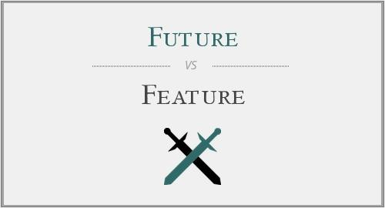
FUTURE AND FUNCTIONALITIE
○ *Features:* ○ 1. *User Profile* – Basic student info, photo, and contact details. ○ 2. *Project Showcase* – Section to display academic and personal projects. ○ 3. *Skills Section* –Visual representation of technical and soft skills. ○ 4. *Resume Upload/Embed* – Add and display PDF resumes. ○ 5. *Certificates Gallery* –Upload and showcase earned certificates. ○ 6. *Media Support* – Add images, videos, documents, and presentations. ○ 7. *Contact Form* – Allow visitors to send messages or inquiries. ○ 8. *Customizable Layout* – Students can personalize fonts, colors, and sections. ○ 9. *Mobile Responsiveness* –Works on phones, tablets, and desktops. ○ 10. *Social Media Links* – Add links to LinkedIn, GitHub, etc.

Slide 10
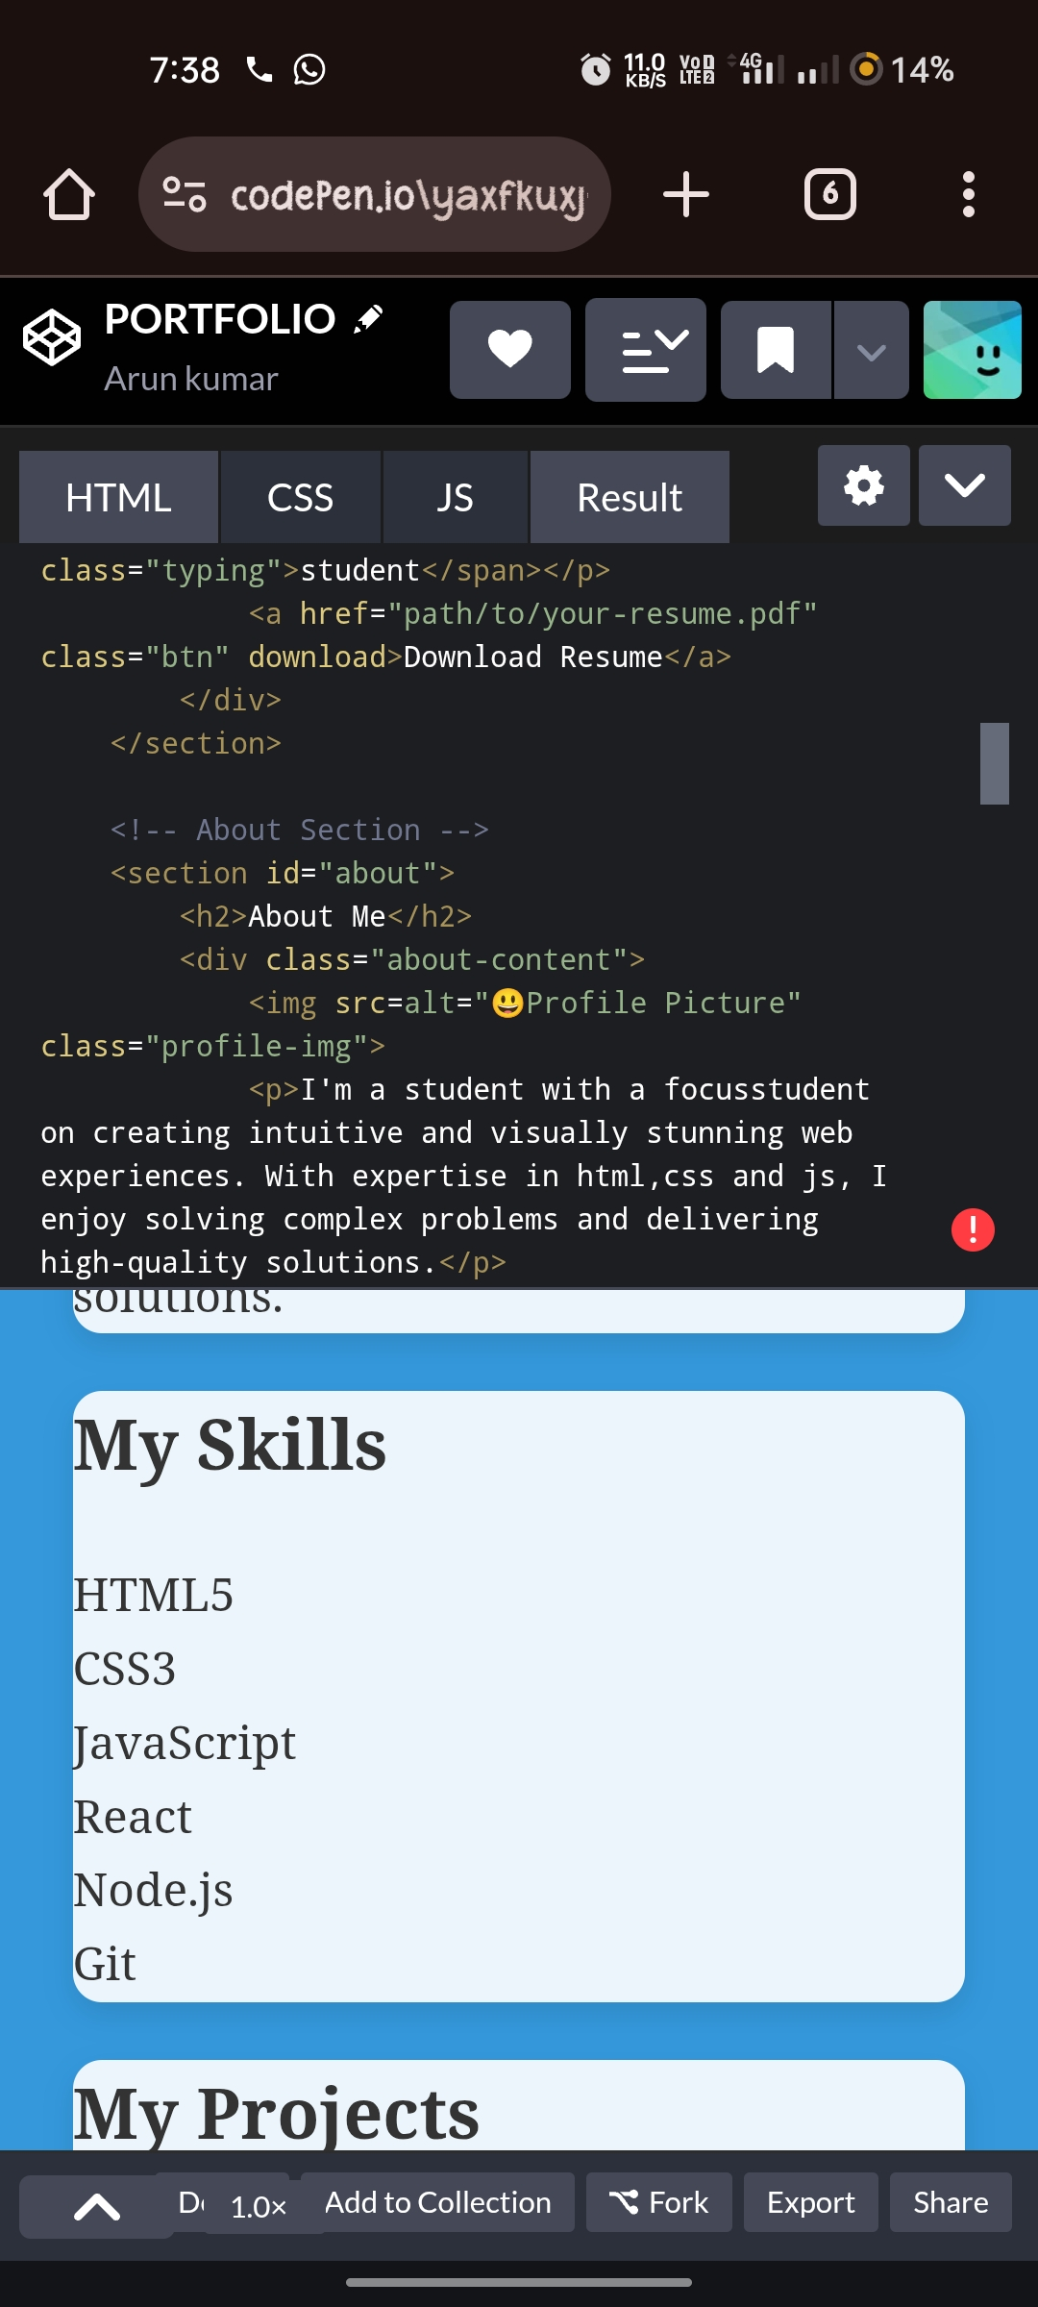
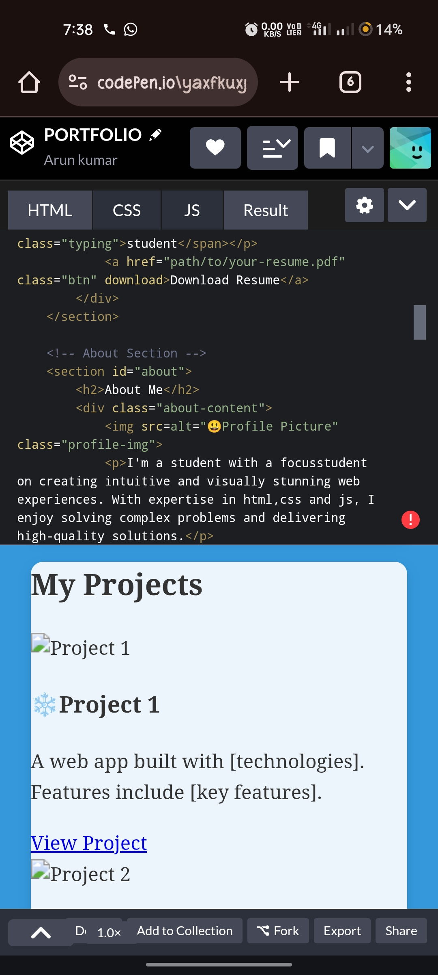
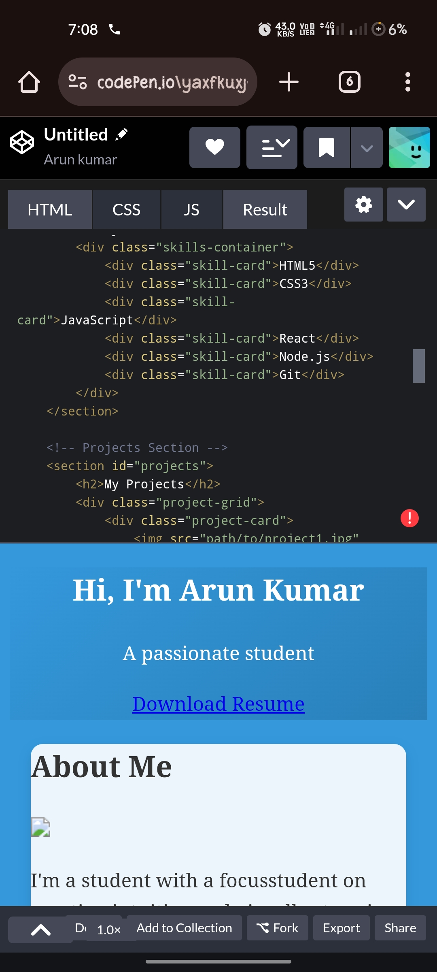
RESULT AND SCREENSHOT

Slide 11
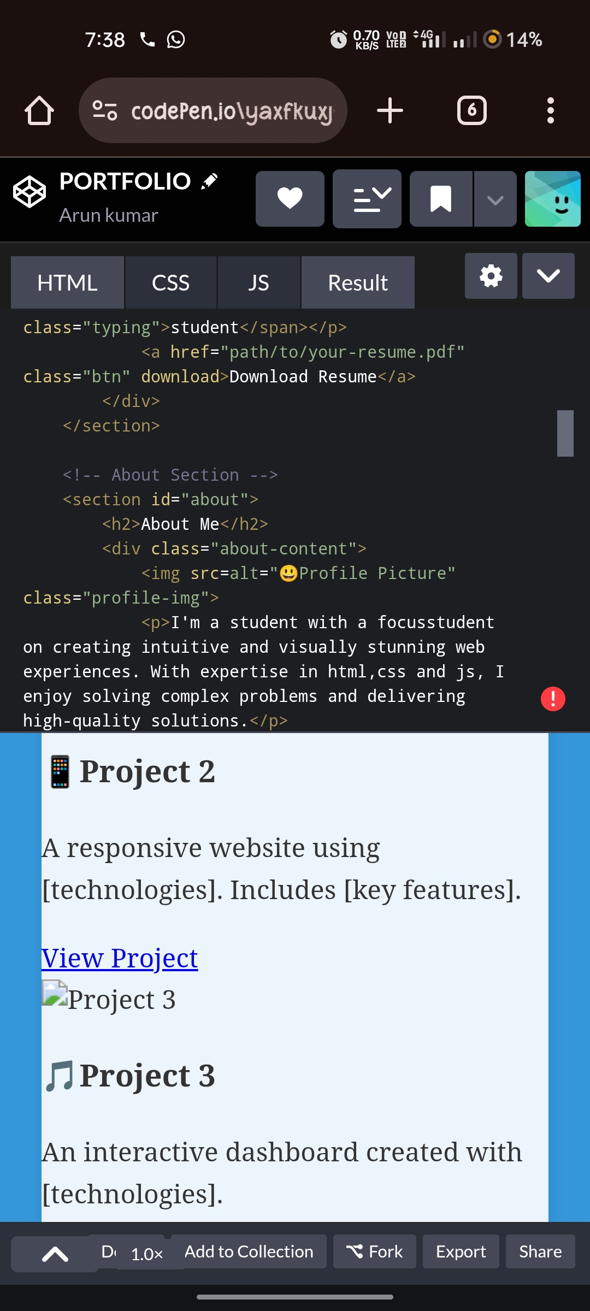
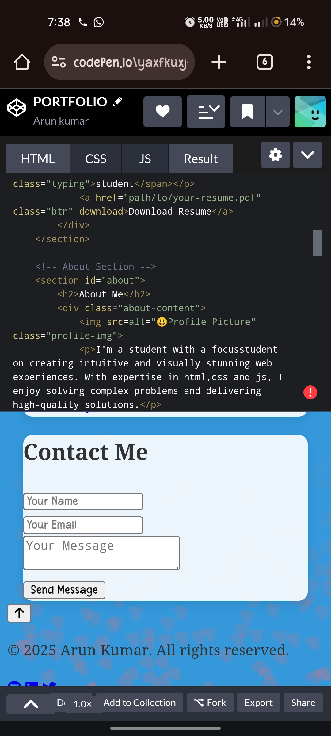
RESULT AND SCREENSHOT

Slide 12
CONCLUSION
○ *Conclusion:* ○ The digital portfolio serves as a powerful tool for students to present their academic achievements, skills, and personal growth in a structured and visually appealing format. It not only enhances selfreflection and goal-setting but also prepares students for future academic and professional opportunities. By integrating technology into personal branding, the digital portfolio promotes creativity, confidence, and digital literacy—essential skills for the modern world

Slide 13
GITHUB LINK

